Slide 1
Advanced Results Retrieval System
-A Mini Project
by
D. NARENDRA REDDY (15131A0553)
CH. SAI MANIROOP(15131A0549)
D.MANOJ KUMAR(15131A0550)
CH. NARENDRA(15131A0537)

Slide 2
Agenda/Topics to Be Covered
Abstract
Existing System vs Proposed System
Hardware and Software Specifications
Introduction
UML Diagrams
Source Code and Output
Conclusion
Bibliography

Slide 3
Abstract
Viewing marks from a website has been the hardest part until now because of the tangled URLs.
This results retrieval application uses advanced web scraping techniques to extract the results from college website URLs that have been released till now.
This system analyses the student ID say roll no. and displays the results based on his preferences like Regular or Supplementary or both.
Moreover, this system facilitates the outsiders to conveniently view the results of any student and it is used for the personal assessment based on the obtained result.

Slide 4
Existing System
In the existing system, we may get results only for particular semester
Whether we want to obtain the Regular or Supplementary or Revaluation results we shall remember the result urls and their specific dates
PROBLEMS:
1)If we want to obtain the results of previous semesters, it is very difficult to memorize all their dates.
2)Generally many college websites do not provide a way to obtain all the results of completed results until now.
These are some of the problems faced by the students, parents, faculty members. So, hereby we proposed a new system to obtain all the results at single instance.

Slide 5
Proposed System
In this proposed system, we can get results of all the semesters at once that are completed until now.
In the proposed system, by simply providing the student regd no. and some queries anyone can obtain the results of all the semesters at a time.
Moreover, parents can easily access the results of their wards as parents are aware of only their child’s roll no. There is more scope for adding more features like SGPA or CGPA etc

Slide 6
Hardware and Software requirements
Minimum Hardware requirements
Processor (CPU): Intel core i3(1.8 Ghz)or more/AMD A8(1.9 Ghz).
Memory(RAM) : Min 1GB
Storage(Hard disk): Min 500GB
Active Wi-Fi 802.11 ac/b/g/n or Ethernet Connection.
Minimum Software requirements
Operating system : Ubuntu 14.04 or above / windows 7 and above
Language: Python-2.7
IDE : PyCharm, Atom, Jupyter notebook.
DEPENDENCIES : Beautiful Soup, mechanize, requests, pandas, numpy etc.,
BROWSER : Mozilla Firefox/Microsoft Edge/Google Chrome.
WEB FRAMEWORK : Flask using Python.

Slide 7
Introduction
In the contemporary world, education plays a major role. By which one believes that with education we can do anything we want. So, there are many private and public institutions for educating students.
In this education system, the skill of any individual is assessed based on his/her performance in various aspects. In this digital era, all the results and updates within the institution are maintained through their official websites.
With the help of college website, all the students and Faculty will be able to know each and every updates and news regarding any semester results, new time tables. The teachers, parents and students can know the placements of the students in any college through their official website.

Slide 8
But in some college websites like GVPCE, the retrieval of semesters results is not so good. Anyway students will be able to find their results of latest semester at ease.
As the parents are not so aware of all the details of their wards current study, it becomes quite difficult to know their wards results. The difficulty here is we can get the results only for particular semester.
If we want to know or check the previous results of any student it is the hardest part because of the tangled urls and they need to remember the dates of the commencement of results.

Slide 9
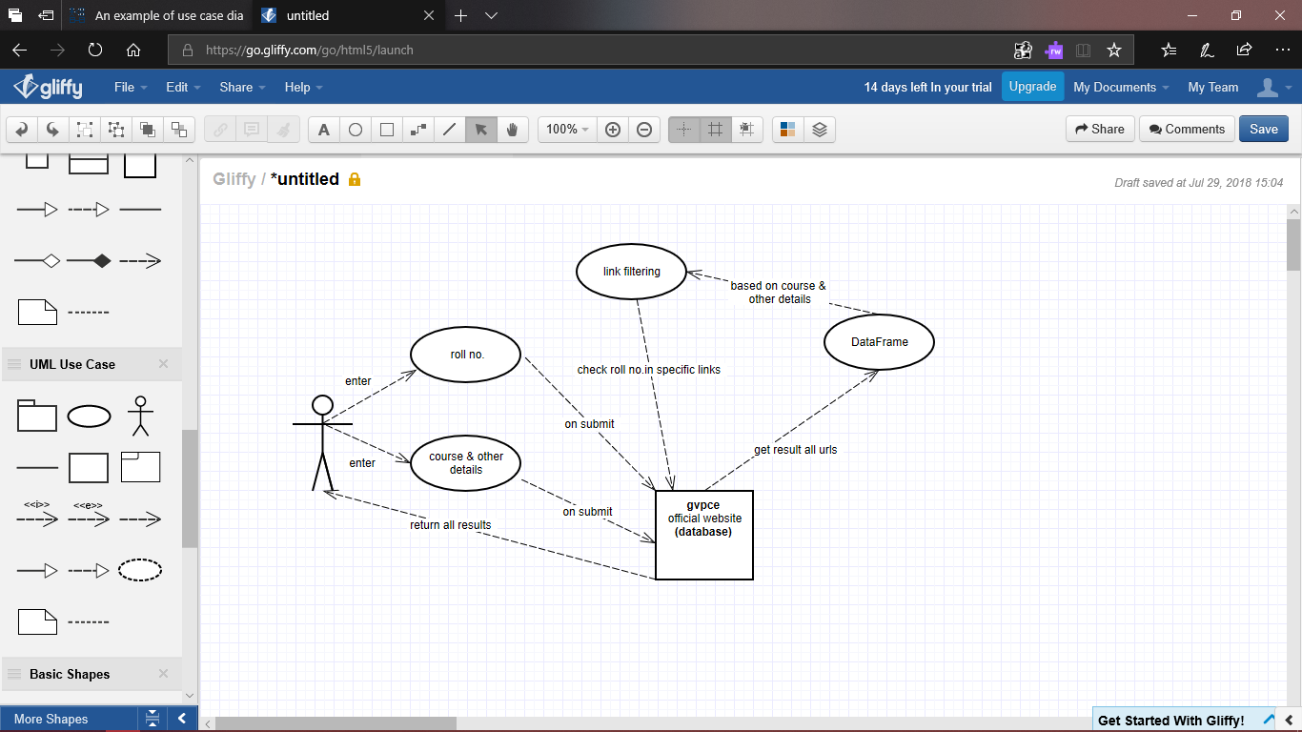
UML Diagrams
1.USE
CASE
DIAGRAM:

Slide 10
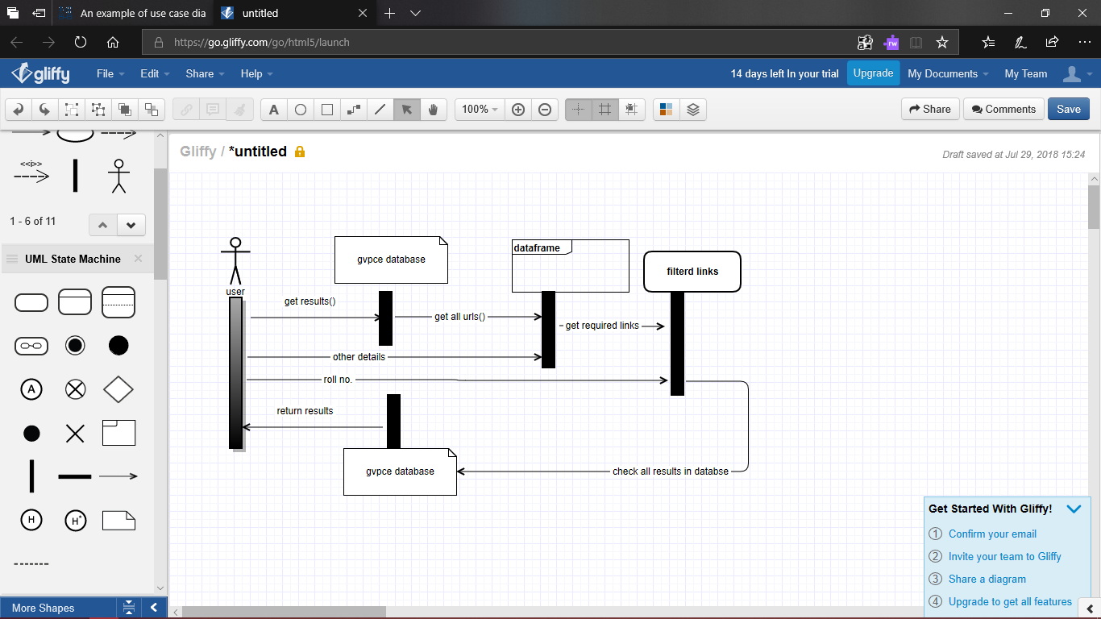
UML
2.SEQUENCE DIAGRAM:

Slide 11
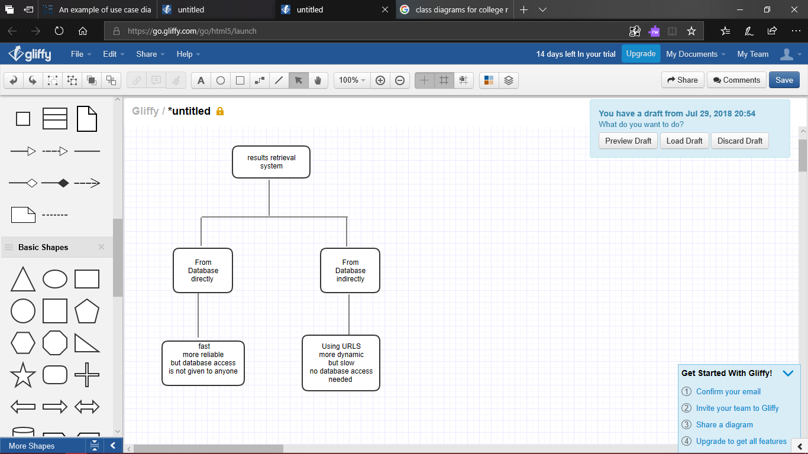
UML
3.CLASS DIAGRAM:

Slide 12
ALGORITHM
Step-1:First store all the urls of results and the corresponding title in a dataframe
Step-2:Filter all the links in the dataframe depending on the queries we choose.
Step-3:Only few urls are left in which we want to check all the results.
Step-4:We should enter the roll no.,then all the results in each filter urls gets concatenated to other and then the final result is displayed
Step-5:Thus all the completed results of the student are displayed at a single instances.
Step-6:Finally the web app is deployed in pythonanywhere or heroku.

Slide 13
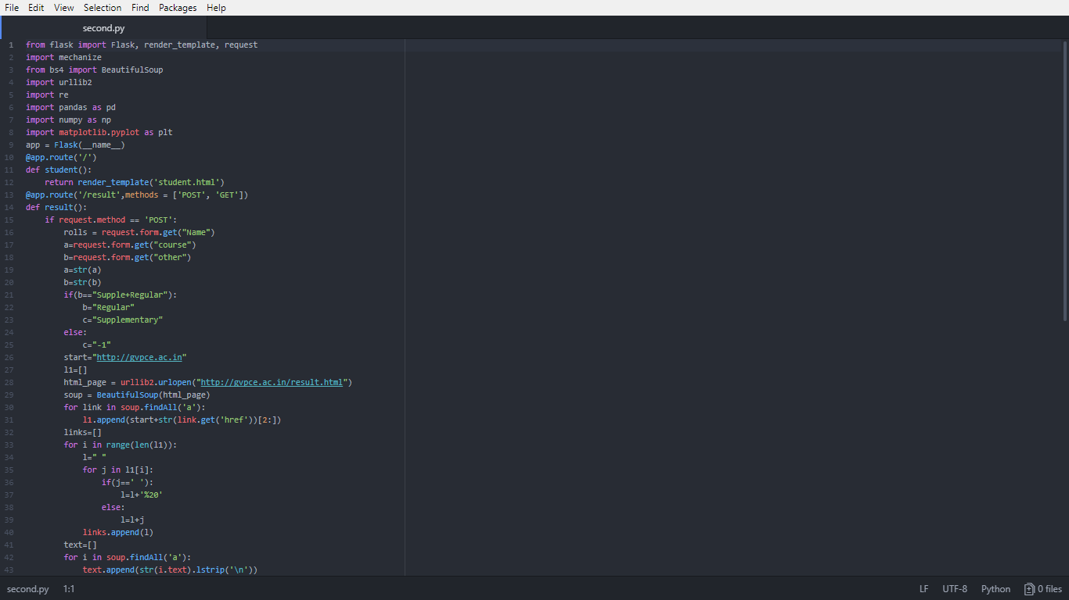
Source Code: second.py

Slide 14
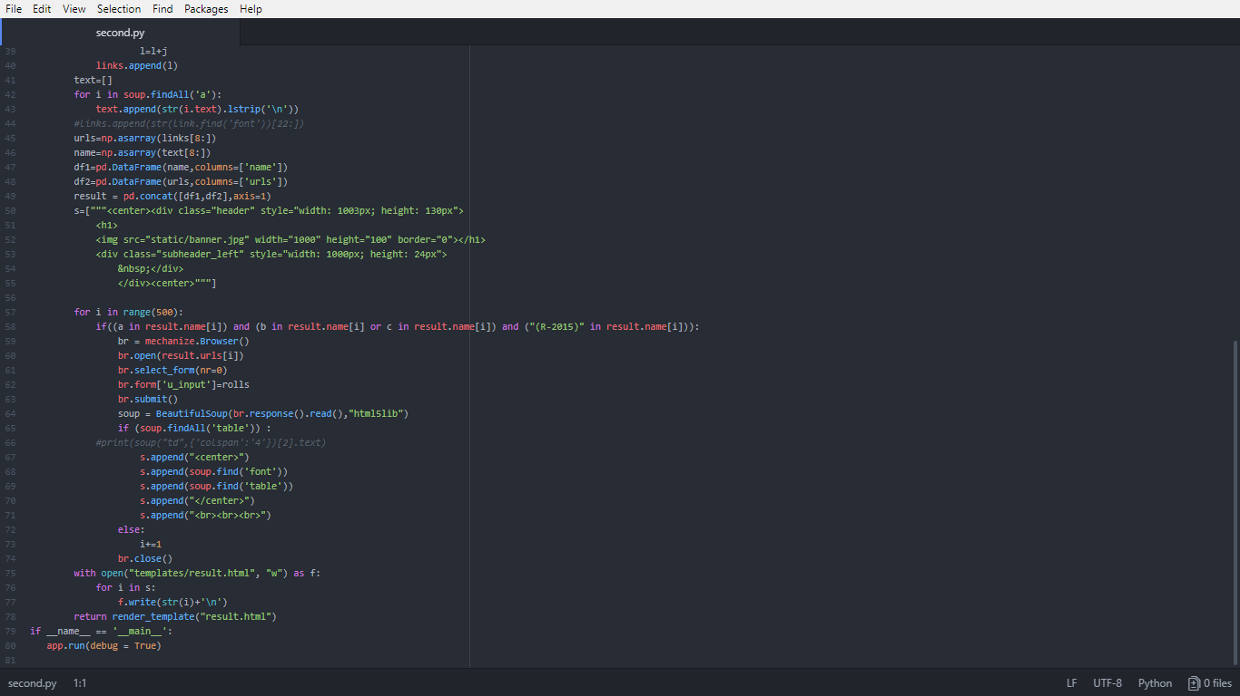
Source code

Slide 15
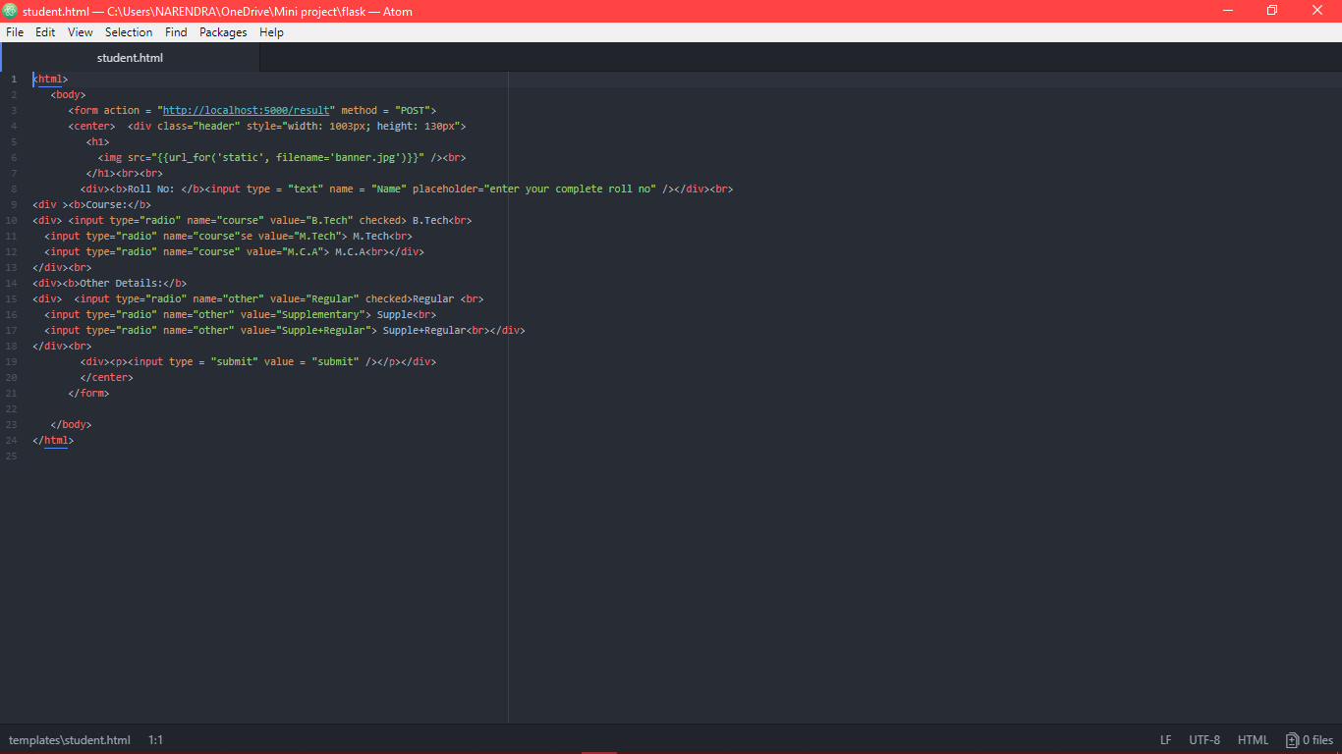
Student.html

Slide 16
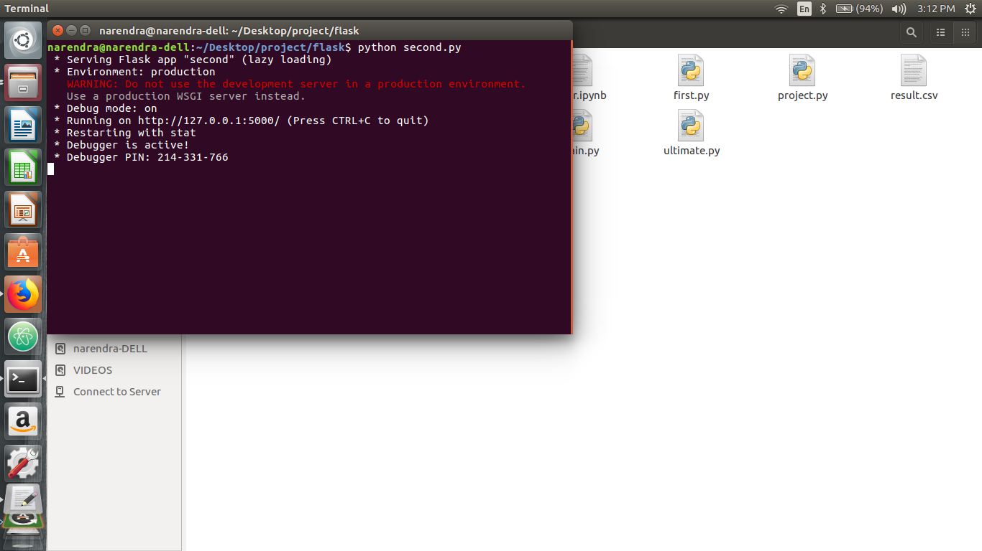
OUTPUT SCREENS
Running the second.py in terminal

Slide 17
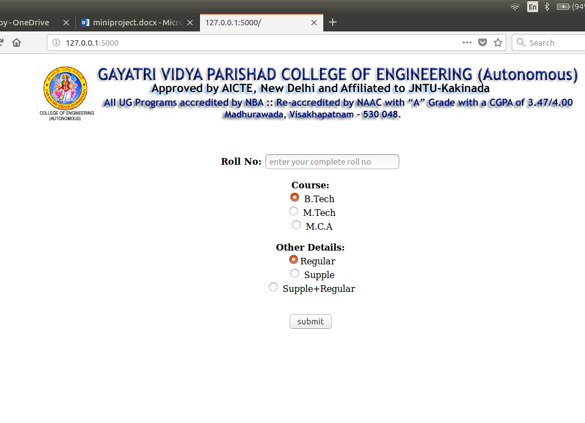
Student.html gets executed in the local server:

Slide 18

User enters the desired roll no and radio buttons

Slide 19
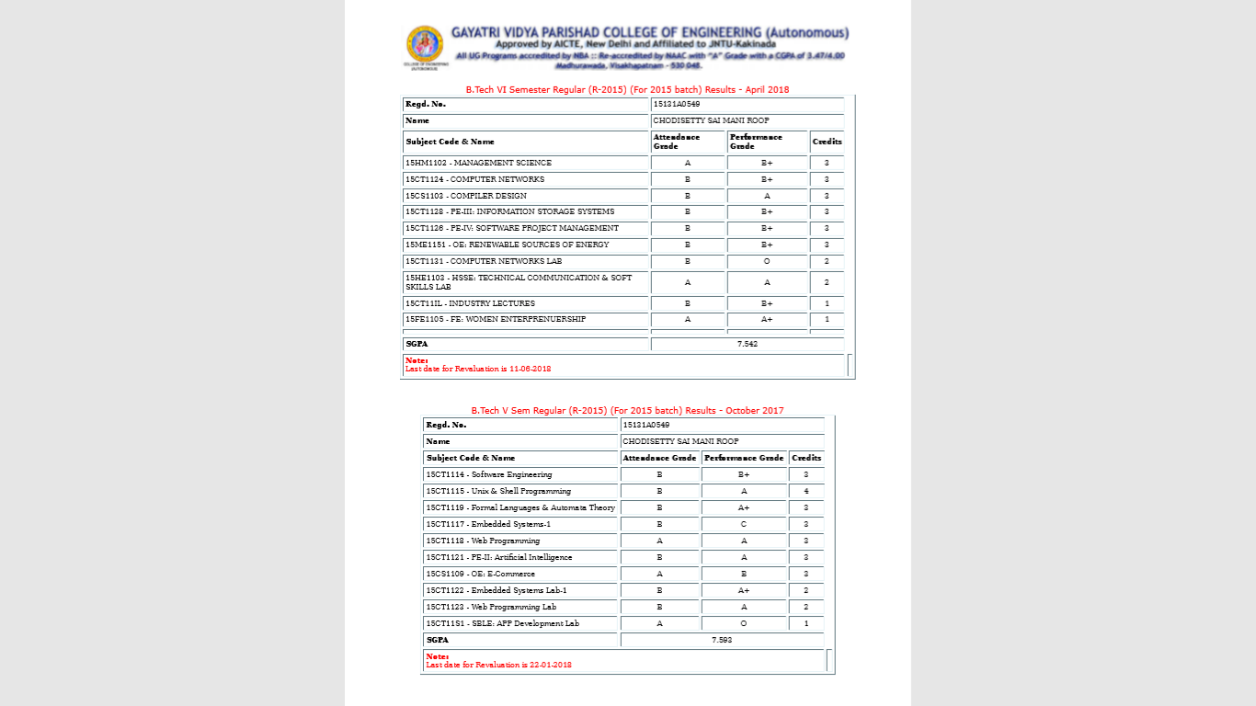
After submitting , The local server is redirected to the results page as follows:Result.html

Slide 20
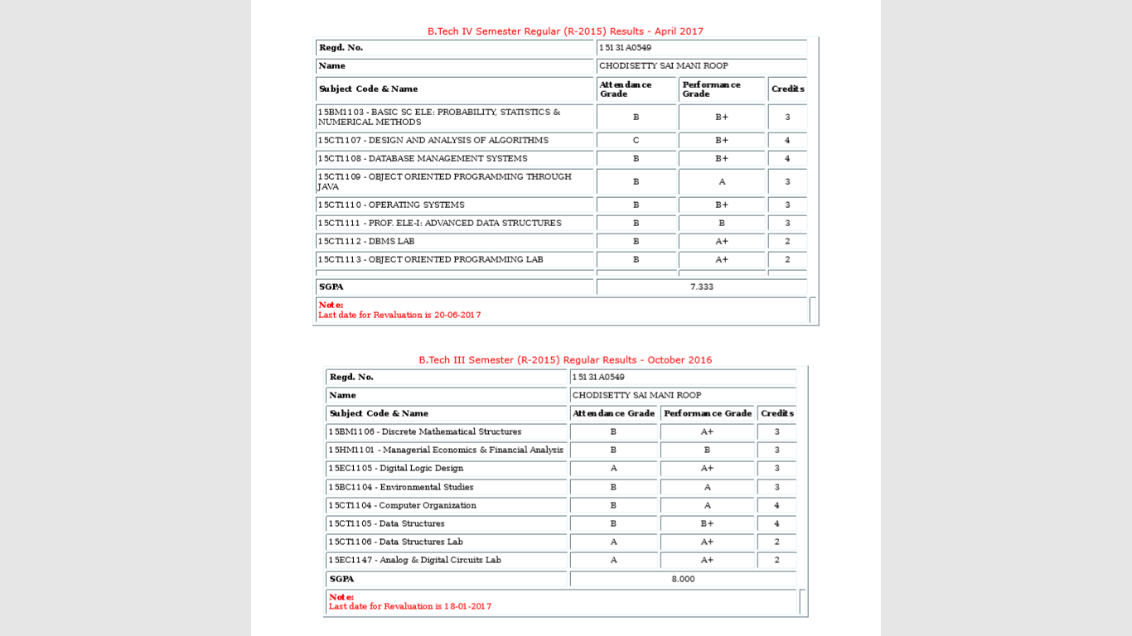

Slide 21
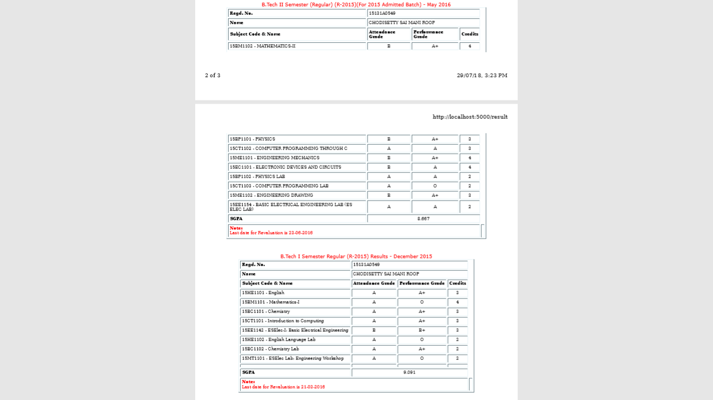

Slide 22
CONCLUSION
Hereby we can conclude that student life begins easy by using this web app. In this digital world, the technology is updating every second, so with the help of advanced technologies we can make our life a cake walk. And learning is a never ending process. Now –a –days python programming language is developing and evolving in a very fast pace which paved a way to complete this mini project successfully.

Slide 23
BIBLIOGRAPHY
9.1 REFERENCES:
https://www.gvpce.ac.in/
http://gvpce.ac.in/result.html
9.2 LIST OF WEBSITES:
https://docs.python.org/3/
https://www.crummy.com/software/BeautifulSoup/
http://flask.pocoo.org/
https://www.pythonforbeginners.com/mechanize/browsing-in-python-with-mechanize/
https://docs.python-requests.org/en/master/
https://github.com/jupyterlab/jupyterlab/
https://www.python.org/

Slide 24



Q&A
Invite questions from faculty/students.

Slide 25
THANK YOU

